Slide 1
Configurable Robotic Platform
2016 ESE PRACTICUM PROJECT

Slide 2
Topics
Problem
Project Motivation
High Level Drivers

Slide 3
Problem
There are many cases in industry, government, and academia that engineers and researchers want to test devices, sensors, control strategies, etc. on a robotic platform.
They don’t want to build a robot just to test their “stuff.”
costly and time consuming
Hacking existing robots is problematic.
voids warranties
voltage/current in compatibilities
no place to mount devices
hard or impossible to hack (software)

Slide 4
Laptop
USB
Core/robot control center
Battery
Motor controllers

Slide 5
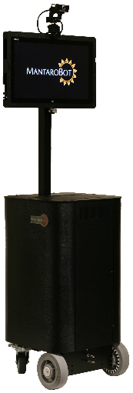
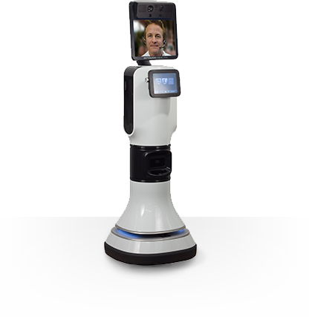
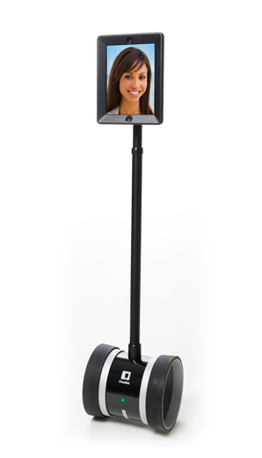
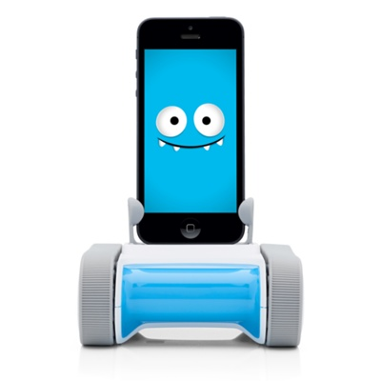
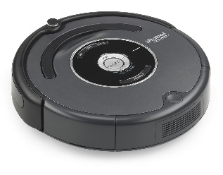
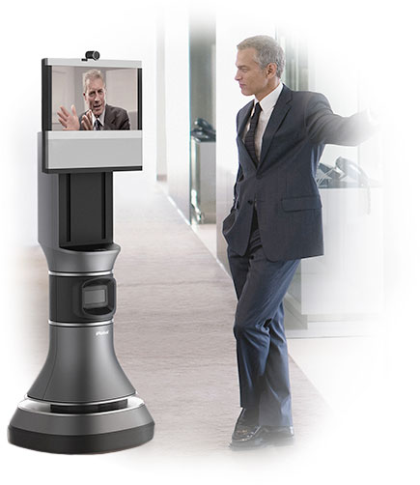
Example Bots on the Current Market
MantaroBot
(~$5K+)
RP-VITA
Telemedicine
(~$50K+ monthly subscription)
There are several robots on the market that are often “hacked” for research purposes.
The majority are geared toward telepresence in the form of mobile, in-situ teleconferencing.
Some focus on specific domains – medical, military, security,… this represents a much smaller market.
Others are toys. None serve general research purposes
Romo
(~$200)
Eva
(~$5K+)
Roomba
(~$1K)
Double Robotics
(~$3K)

Slide 6
Project Motivation and Goals
Engineers and researchers are often forced to use robots that are not designed specifically for their research, test, and/or development purposes. Their needs often include:
development of special control and/or access to control software
development, test, and experimentation of application level software
ability to easily add new hardware elements physically, electrically, and software for test and experimentation
easy access to system hardware and power
The goal of this project is to build a general purpose, mobile robot, designed to meet these needs of engineers and researchers in industry, government, and academia.

Slide 7
Basic Requirements – 1
Design an “open” robotic platform that supports the following needs:
enable a developer to use their own laptop (Mac or Window) to connect to the robot via USB
provide simple communication protocol vis-à-vis an open API accessible from their own laptop
the laptop will be used to develop applications that will use the robot
the robot will provide basic services such as motion, basic collision detection, error management and others TBD
the API will allow programmers to access to the robots services

Slide 8
Basic Requirements – 2
Current prototype platform:
provides “hard points” to mount sensors, actuators, and various other hardware
provides access to 12V/60A deep charge marine battery power
two high power drive motors and motor control hardware
What is needed:
control-communication hardware
control software
API
basic collision detection system
power monitoring
comprehensive demo
APIs should support programmers using Java and C.
Laptop
Mount Points
Power
Propulsion

Slide 9
Basic Requirements – 3
You can use the 300 SCR facility as a test environment
carpeting/linoleum floor, crossing thresholds (elevator, break area), fit through doors and passageways,…
Demo is TBD:
telepresence? office service? remote semi-autonomous control?
should illustrate all basic features of the system
transit
We will need comprehensive developers documentation.

Slide 10
Key Goals
High priority goals:
control-communication hardware & associated control system software
basic collision detection system
API supporting Java
basic demo illustrating basic features above
Secondary goals:
power monitoring
support for C API
comprehensive demo illustrating a couple of different applications, a laptop swap to a second application

Slide 11
Key Stakeholders
Me – I will…
approve designs, procurement choices, demo, test plans and acceptance
designed, built, and will modify the prototype platform as necessary

